Slide 1
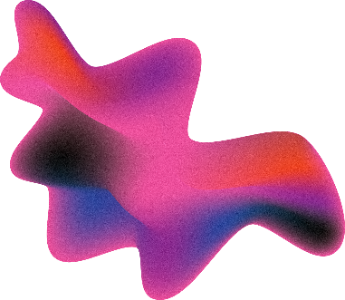

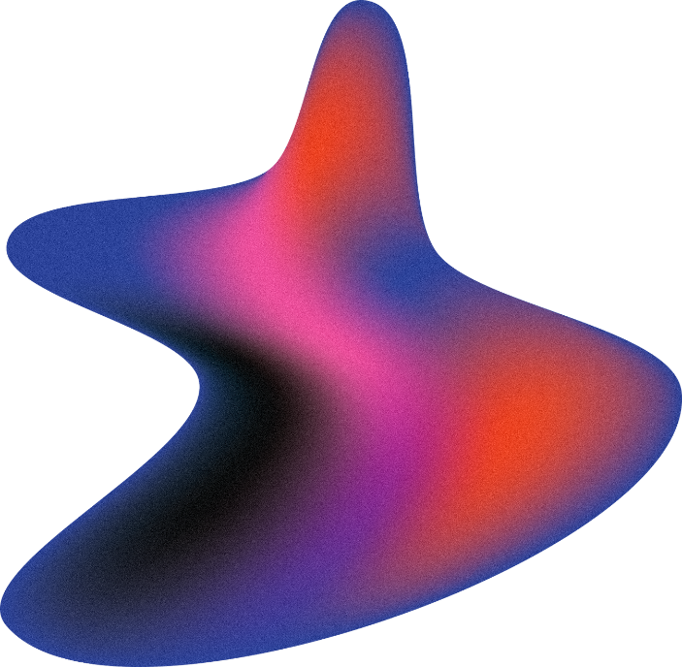
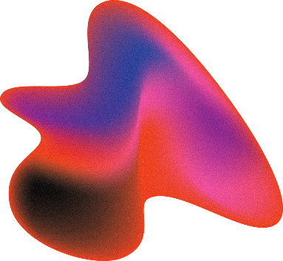
Face Recognition using Siamese Neural Network

Slide 2
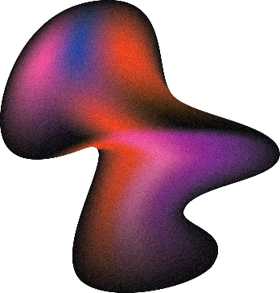

CONTENTS
1. Introduction
2. Related Work
3. Definitions
4. Datasets Information
5. Methodology
6. Applications and Advantages
7. Conclusion
VIKRAM.M – AP21110011337

Slide 3

INTRODUCTION
In the rapidly evolving landscape of facial recognition technology, the pivotal role of recognizing individuals based on their facial features has gained immense significance. Deep learning stands as a powerful cornerstone within this domain, employing vast collections of images to train models and discern the unique characteristics that distinguish one face from another. This process involves encapsulating distinctive facial attributes into a database, enabling subsequent comparisons during face recognition tasks.
Our focus centers on elevating the performance of Convolutional Neural Networks (CNNs) in terms of accuracy, generalization, and inference speed. CNNs, a pivotal facet of deep learning, excel in processing visual data. Comprising layers for convolution, pooling, and fully connected nodes, these networks adeptly extract and amalgamate visual features. Their prowess has notably revolutionized face recognition methodologies.
VIKRAM.M – AP21110011337

Slide 4

INTRODUCTION
Furthermore, we delve into the realm of one-shot learning—a machine learning paradigm that challenges models to make accurate predictions or classifications with minimal training data, presenting only a single instance of each class. This approach showcases its prowess in training Siamese neural networks, a twin-network architecture that excels in discerning similarity and dissimilarity between input samples. Such innovations open doors not only to accurate predictions on new data but also to novel categories previously unseen by the model.
VIKRAM.M – AP21110011337

Slide 5
RELATED WORK
Exploration into one-shot learning has its roots in the early stages of machine learning, striving to achieve accurate predictions or classifications with limited training data. Pioneering work in the early 2000s, such as Li Fei-Fei et al.'s endeavors, initiated unique approaches to one-shot learning, particularly in character recognition. Hierarchical Bayesian Program Learning (HBPL), an innovative method adopted by Lake and collaborators, deconstructed images into smaller elements to discern their structural contributions to the overall image perception. However, the computational complexity of HBPL posed challenges in practical implementation.
Maas and Kemp's groundbreaking research in 2009 revolutionized Bayesian networks, enhancing their predictive capabilities in contexts beyond face recognition. Lim's work in 2012 prioritized practical strategies for handling limited datasets within specific classes, significantly impacting the landscape of classification tasks.
VIKRAM.M – AP21110011337

Slide 6
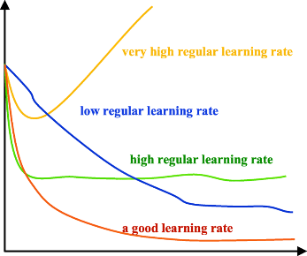
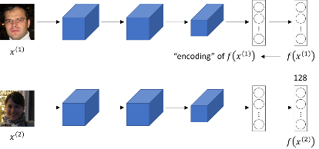
THINGS TO KNOW!
Learning Rate:
The learning rate serves as a crucial hyperparameter determining the algorithm's pace in updating parameter estimates during learning. It signifies the frequency at which a neural network assimilates new knowledge.
Striking a balance in the learning rate is pivotal; excessively large rates risk converging swiftly to suboptimal solutions, while extremely low rates may prolong the learning process, potentially causing stagnation.
Siamese Neural Network:
Often referred to as twin networks, Siamese neural networks incorporate identical subnetworks with matching configurations, parameters, and weights. Renowned for their ability to learn effectively from minimal data, these networks excel in discerning similarities between data points.
Leveraging binary cross-entropy or triplet loss functions, Siamese networks are adept at identifying data similarities, making them pivotal in various classification tasks, including face recognition.
UMA MAHESWAR REDDY. N – AP21110011305

Slide 7
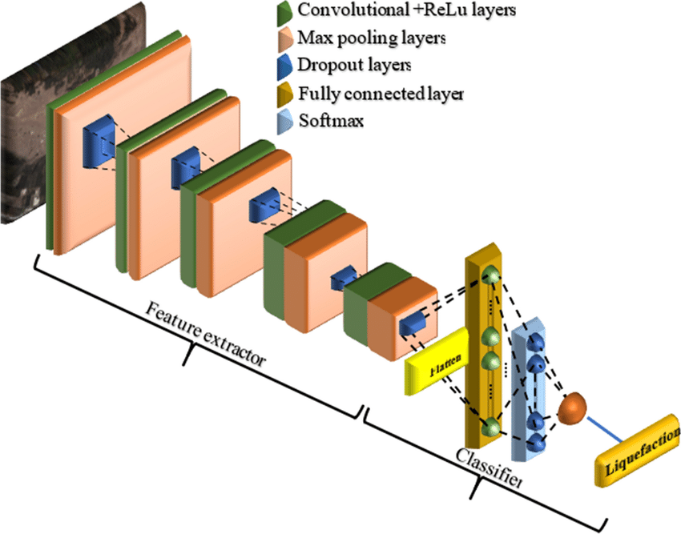
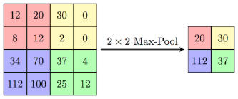
THINGS TO KNOW!
Convolutional Neural Networks (CNN):
CNNs represent a neural network architecture specifically tailored for image recognition and processing tasks involving pixel-level data manipulation. Comprising convolutional, pooling, and fully connected layers, CNNs are adept at feature extraction from visual inputs.
The convolutional layers apply filters to extract crucial features like shapes and textures, while the pooling layers reduce spatial dimensions, retaining essential information. The subsequent fully connected layers facilitate classification and prediction tasks.
Max Pooling:
Max pooling, a common operation in CNNs, involves selecting the maximum element within a filter-covered region. This operation effectively condenses important features from the preceding layer into a feature map.
UMA MAHESWAR REDDY. N – AP21110011305

Slide 8
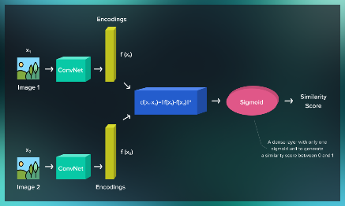
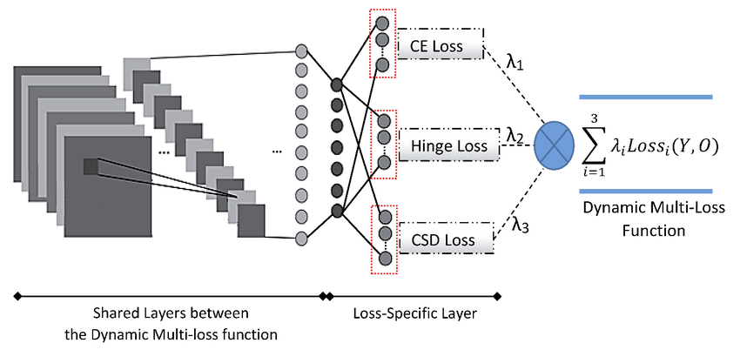
THINGS TO KNOW!
One-Shot Learning:
This learning paradigm involves training models to make predictions based on a single example per class. Unlike conventional computer vision projects requiring extensive data, one-shot learning operates efficiently with limited training datasets.
Optimizer:
Optimizers fine-tune model parameters to minimize the loss function, enhancing a model's predictive capability on given datasets. Diverse optimization algorithms, such as the Adam optimizer, impact model performance.
UMA MAHESWAR REDDY. N – AP21110011305

Slide 9
HOW OUR MODEL WORKS.
In our research, our focus primarily revolves around character recognition, a fundamental approach extendable to various other models. Central to our exploration are Convolutional Neural Networks (CNNs) and Siamese Neural Networks, both extensively utilized in person classification based on facial features.
Our approach commences with the preprocessing of dataset images, resizing them to a uniform 100x100 pixel size, optimizing memory and ensuring consistency throughout the training and testing phases. Augmentation of this data proves instrumental, enhancing model robustness and streamlining the training process. Augmentation involves pairing anchor images with positive or negative images, assigning label '1' for positive pairings and '0' for negative ones, facilitating comparative training.
The crux of our model involves Siamese networks, incorporating CNNs within their architecture. This design, characterized by convolution layers, activation functions, feature maps, and distance computation layers, undergoes rigorous training using the augmented dataset. By learning diverse structural and shape nuances from input images, the model's performance is subsequently evaluated using a segregated testing dataset.
SAI CHARAN TEJA. J – AP21110011314

Slide 10
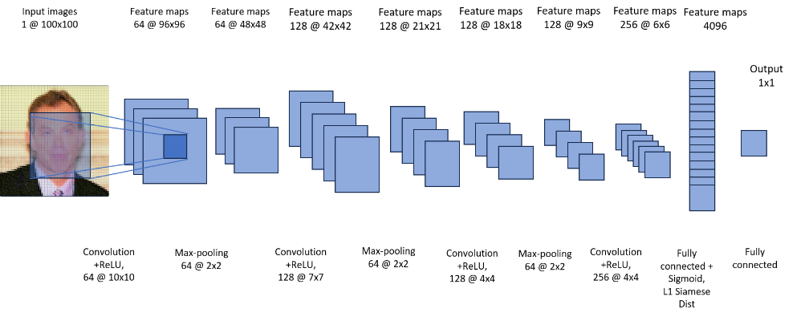
HOW OUR MODEL WORKS.
Supervised metric-based approaches with Siamese networks facilitate learning representations of various images. Leveraging these learned features, the model embarks on one-shot learning tasks without requiring retraining, a testament to its adaptability and efficiency.
SAI CHARAN TEJA. J – AP21110011314

Slide 11
HOW OUR MODEL WORKS.
The utilization of Rectified Linear Units (ReLU) in initial layers and sigmoidal units in subsequent layers bolsters the model's adaptability to complex relationships within the data. The model's architecture progresses from convolutional layers to fully connected layers, culminating in a layer computing induced distance metrics between Siamese twins. This information is then channeled into a single output layer employing sigmoid activation.
SAI CHARAN TEJA. J – AP21110011314

Slide 12
HOW OUR MODEL WORKS.
To quantify the model's learning, we employ a length-M vector to label each mini-batch. This labeling system signifies whether input pairs belong to the same class (label '1') or different classes (label '0'). A standard cross-entropy objective is imposed on our binary classifier, steering the model towards optimal classification.
Utilizing standard backpropagation algorithms and tied weights in twin networks, we optimize our Siamese network model for the verification task. The learned features during one-shot learning are meticulously examined for their discriminative potential, elevating the model's efficiency in discerning intricate facial structures.
Performance evaluation of our model extends beyond mere training metrics, delving into Precision and Recall measurements. Precision, an indicator of our Siamese model's accuracy in recognizing positive instances, quantifies the ratio of true positives to the sum of true and false positives. On the other hand, Recall, also known as the true positive rate, gauges the model's ability to correctly identify actual positive instances among all positive predictions made.
SAI CHARAN TEJA. J – AP21110011314

Slide 13
ADVANTAGES
Siamese Networks showcase versatility across diverse fields, particularly in face recognition using deep learning. Unlike CNN-based models requiring extensive training and ample input data, Siamese networks excel with fewer images, swiftly computing image similarity scores.
Initially validated with self-generated datasets, our focus transitioned to real-time datasets, refining the model's adaptability. Our model's evaluation, emphasizing image classification, leverages layers computing distance errors between images, aiming for precise outcomes in each combination.
Augmenting convolutional layers and max-pooling bolsters error precision, while Adam Optimizer enhances error minimization, consistently improving model performance. Siamese networks' adaptability with limited data and feature discernment make them invaluable, especially in face recognition and broader image classification tasks.
OM SAI. V – AP21110011282

Slide 14
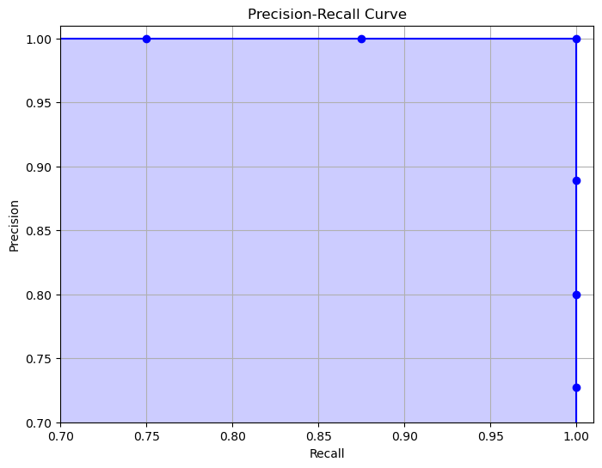
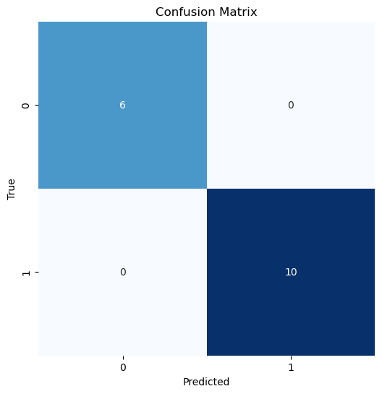
EVALUATION OF OUR MODEL
Our evaluation strategy centered on precision and recall methodologies, complementing our commendable accuracy close to 98% on a smaller dataset. While our initial training showcased high accuracy, real-world testing under varying lighting conditions uncovered areas for improvement. Specifically, the model faced challenges in consistently identifying faces across diverse lighting environments. This insight, gleaned from precision and recall evaluations, offers us a valuable opportunity for enhancement without overshadowing our model's overall success. Through this presentation, we aim to highlight our model's strengths while acknowledging the need for further adaptation to real-world conditions.
OM SAI. V – AP21110011282

Slide 15
CONCLUSION
Our exploration into Siamese Networks and CNNs for face recognition highlights their adaptability and efficiency. The streamlined approach of Siamese networks with limited data contrasts sharply with CNNs, showing promise in diverse applications, particularly image classification.
The model's ability to discern intricate facial features and adapt to various datasets underscores its significance. Augmenting layers and optimizing with Adam Optimizer consistently enhanced the model's performance.
Siamese networks offer a robust alternative, showcasing prowess in recognizing facial structures across varied scenarios. Their efficiency in handling limited data makes them invaluable, underscoring their potential in broader computer vision tasks.
OM SAI. V – AP21110011282

Slide 16


THANK
YOU

